Slide 1
RMSProp (Root Mean Squared Propagation)

Slide 2
RMSprop— is unpublished optimization algorithm designed for neural networks, first proposed by Geoff Hinton in lecture 6 of the online course “Neural Networks for Machine Learning”

Slide 3
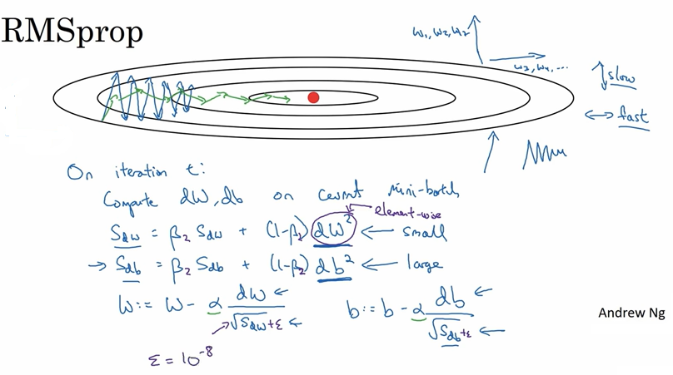

Slide 4
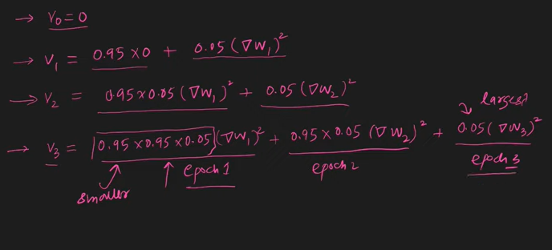
Older avgs. decay with epochs

